Slide 1
Protein synthesis
https://www.yourgenome.org/facts/what-is-gene-expression
Q: Can you explain why do you look different with each other?
Hint: in terms of both genetic information & features.
Gene expression is the process by which the instructions in our DNA are converted into a functional product, such as a protein.
There are two key steps involved in making a protein, transcription and translation.

Slide 2
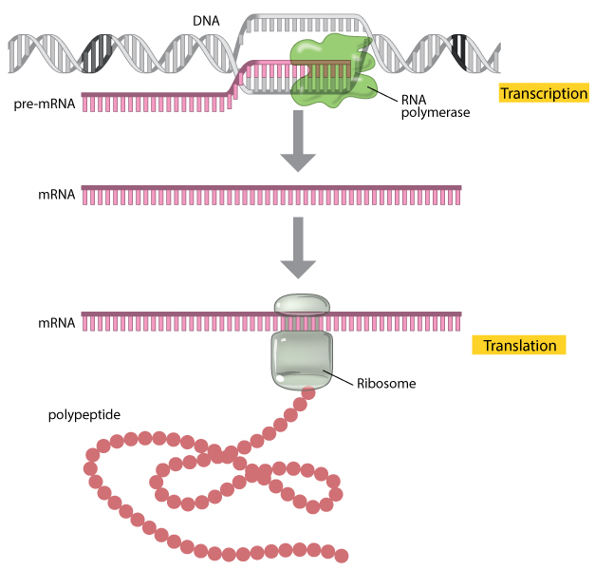

Slide 3
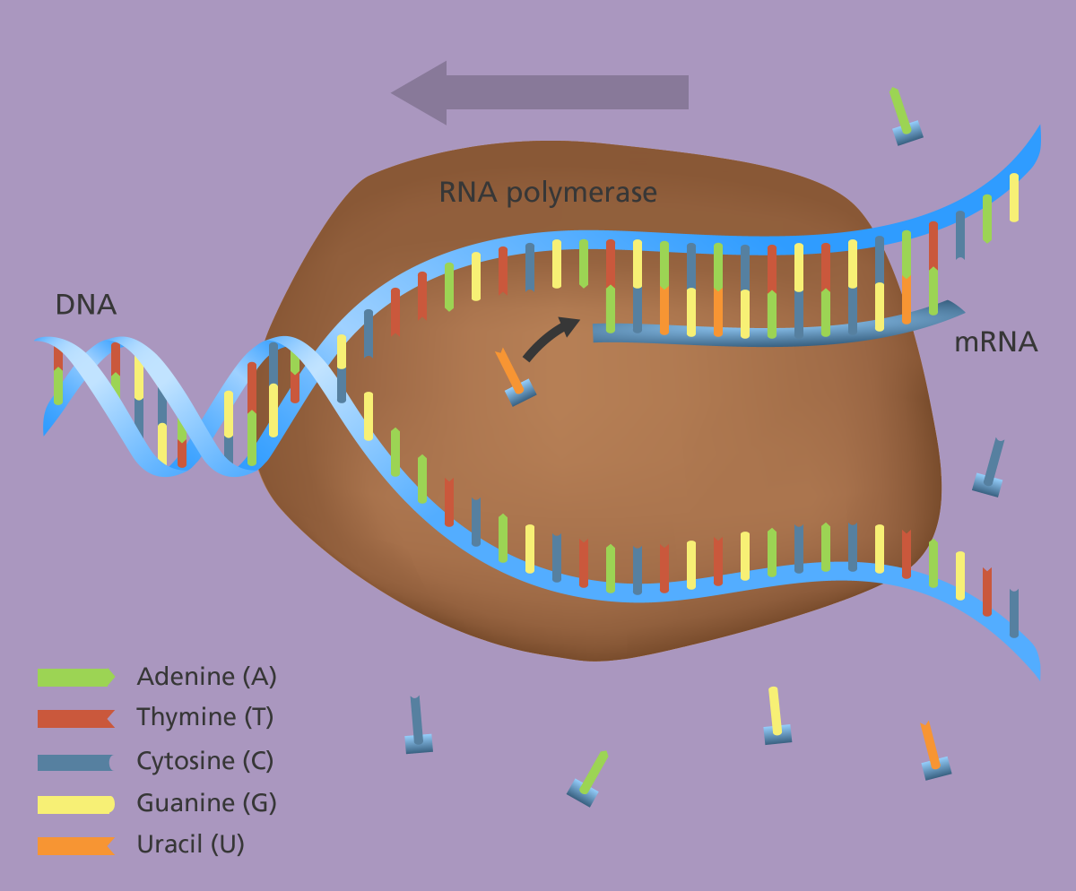
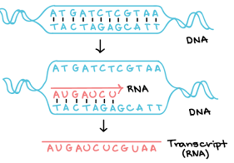
Transcription: from DNA to mRNA
Transcription is when the DNA in a gene is copied to produce an RNA transcript called messenger RNA (mRNA).

Slide 4
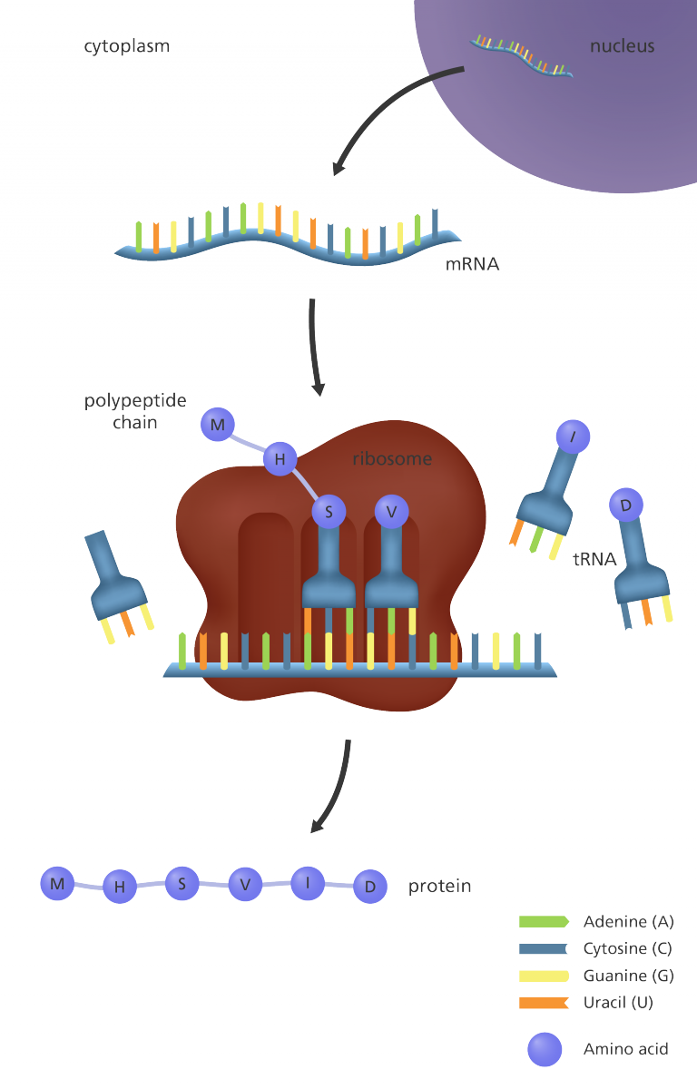
Translation: from mRNA to protein
Translation occurs after the messenger RNA (mRNA) has carried the transcribed ‘message’ from the DNA to protein-making factories in the cell, called ribosomes.
The mRNA is read three letters (a codon) at a time.
Each codon specifies a particular amino acid. For example, the three bases ‘GGU’ code for an amino acid called glycine.
Q: How many types of amino acids are there in organisms? How many possible combinations are there of a three-letter codon?
Notes:
RNA is a chemical similar in structure and properties to DNA, but it only has a single strand of bases and instead of the base thymine (T), RNA has a base called uracil (U).
The message carried by the mRNA is read by a carrier molecule called transfer RNA (tRNA).

Slide 5
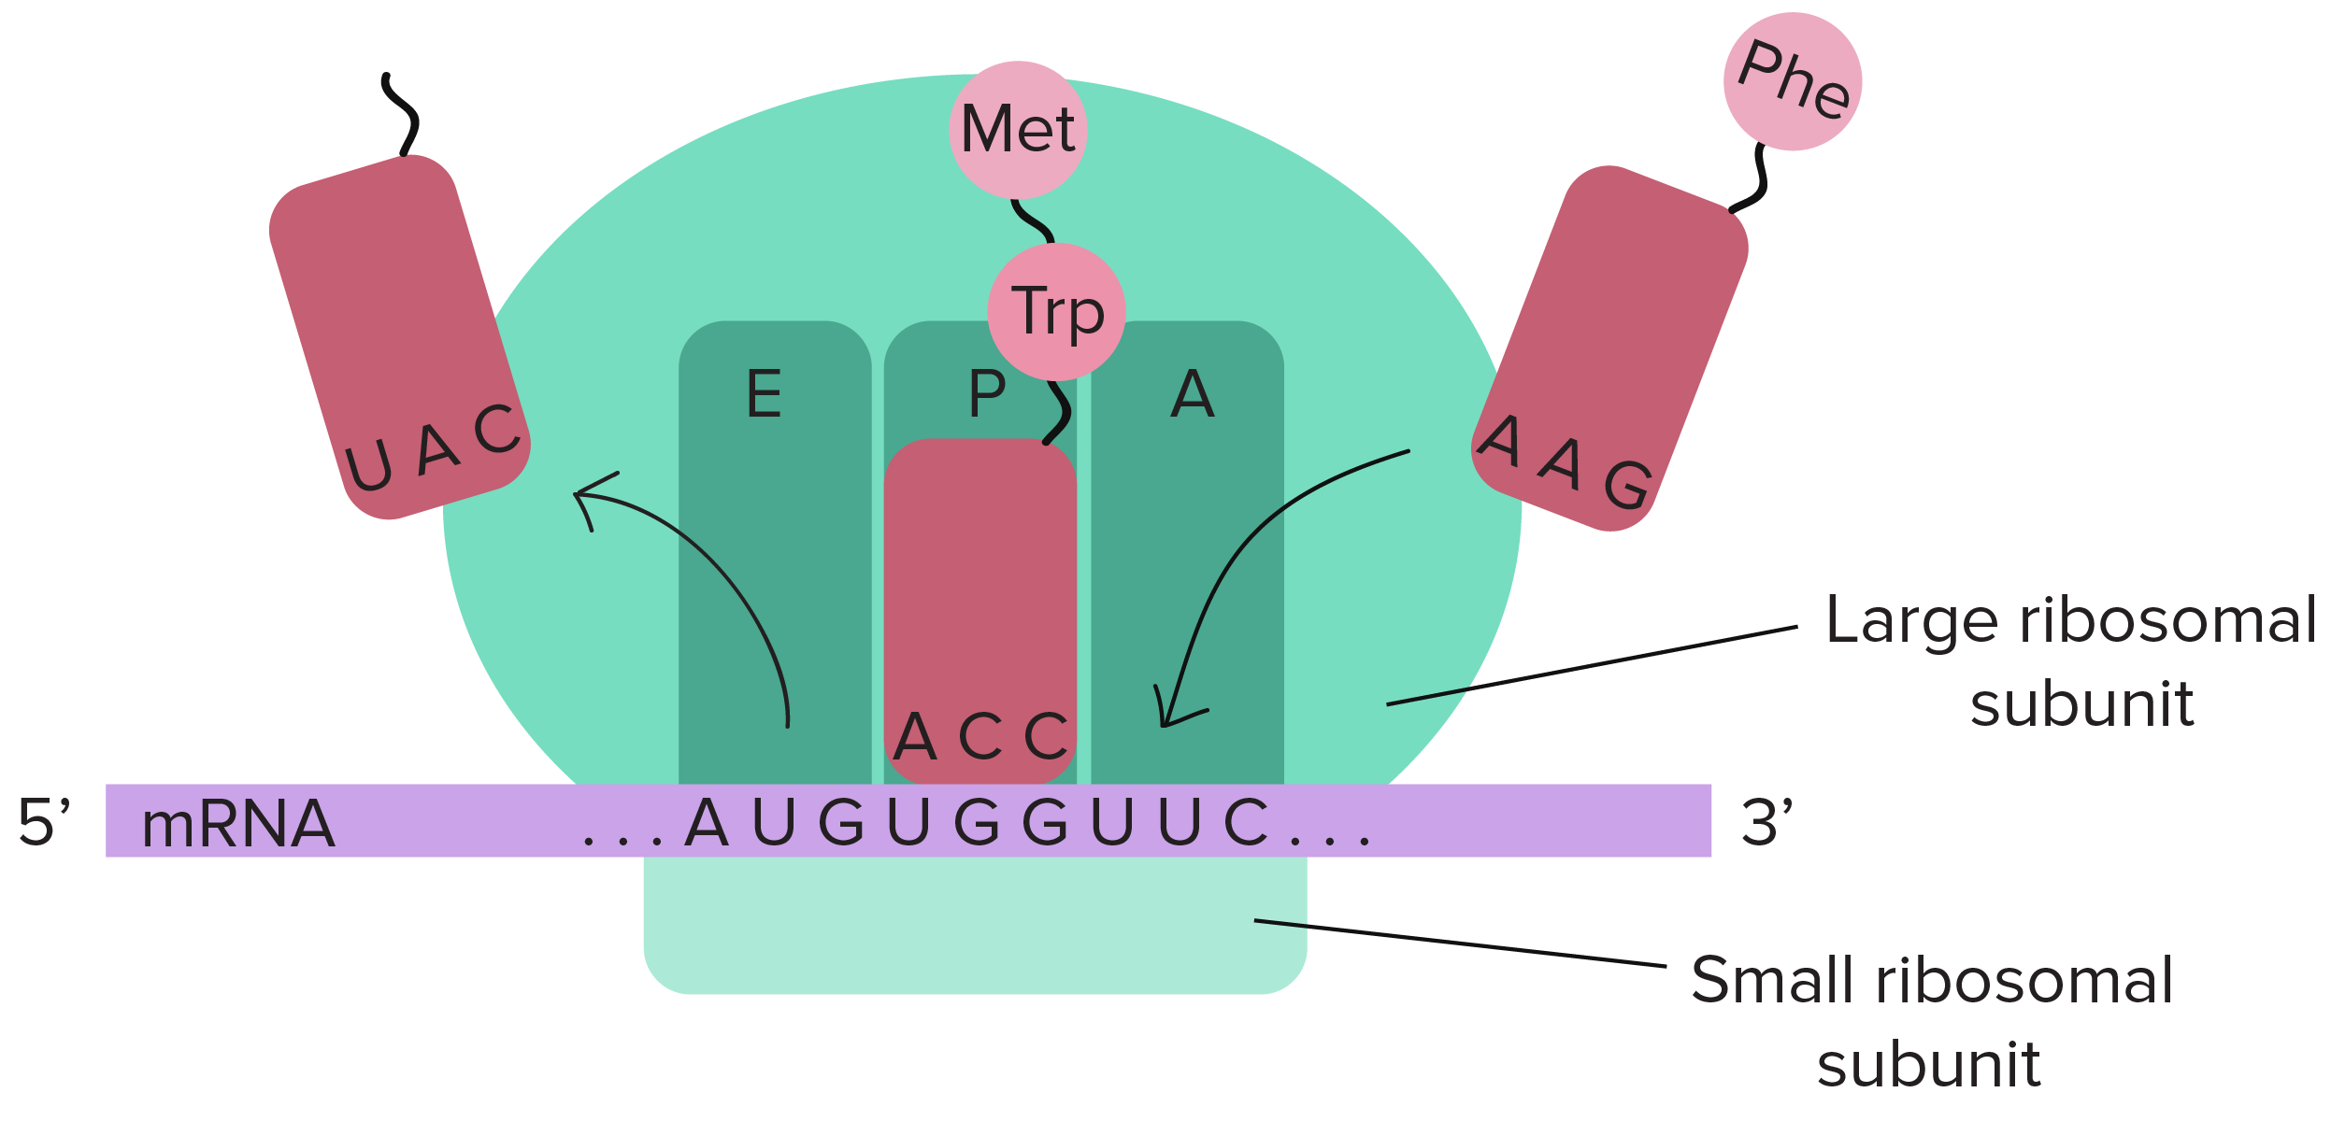
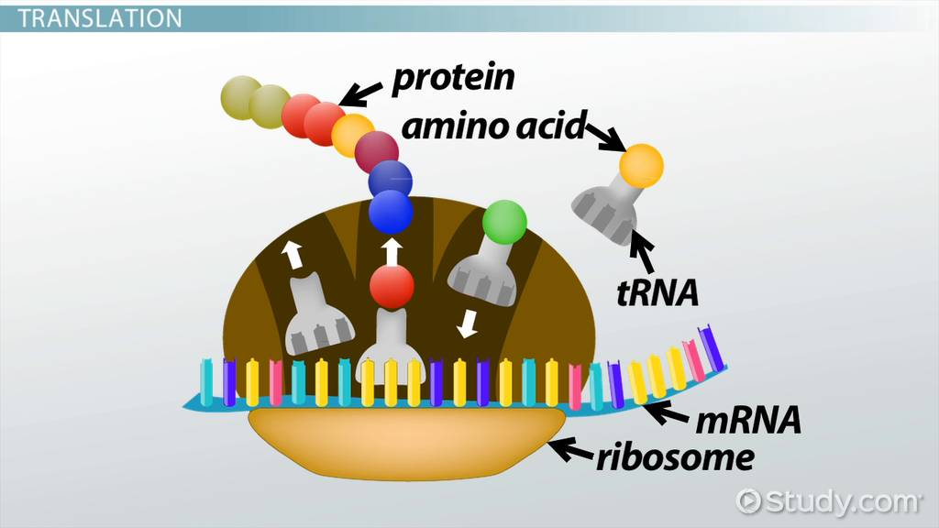
Translation

Slide 6
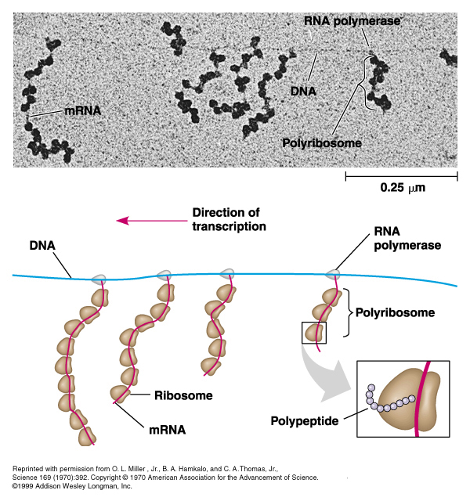
polyribosomes

Slide 7
Genetic code & Triplet codon
How should you understand ”bacteria and humans use the same genetic code”?

Slide 8
Introduction
The genetic code is the set of rules used by living cells to translate information encoded within genetic material (DNA or mRNA sequences of nucleotide triplets, or codons) into proteins.
Translation is accomplished by the ribosome, which links amino acids in an order specified by messenger RNA (mRNA) and reads the mRNA three nucleotides at a time. Each of this three nucleotides together is called a triplet codon, such as ATA, AAA, ATC.
The genetic code is highly similar among all organisms and can be expressed in a simple table with 64 entries.

Slide 9
Codon table
Task: Can you work out the sequence of amino acids this section of mRNA will translate into?

Slide 10
Codon table
FYI, This is a same table as shown in previous slide, just expressed in a different form.

